Slide 2
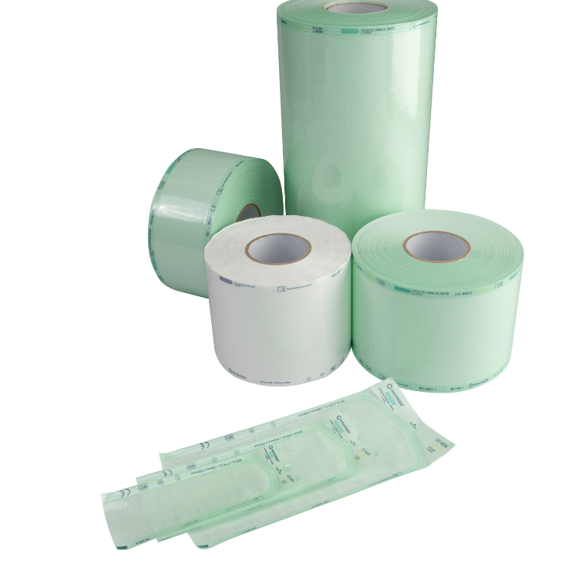
Product Positioning Pouches and Reels
Who uses Pouches and Reels in controlled environments?
Pharmaceutical sterile production: ISO 4/5 or Grade A/B aseptic
Cleanroom laundries: ISO 5/6 or Grade B/C
For what do controlled environments use them?
Inhouse packing + inhouse sterilization of their tools, smaller equipment, garments, goggles, bottles..
Sterilization methods = Autoclave (steam sterilisation) or chemical vapor (plasma) or inhouse ETO.
Inhouse packing + outhouse sterilization of their tools, smaller equipment, raw materials, garments, goggles ...
Sterilization methods = outhouse ETO or gamma/beta radiation

Slide 3
CE Certificated – Compliant to
ISO 11607-1, EN868-5 acc, ISO TS16775
Sterilisation methods
Validations: ISO 11140-1, ISO 11138, ISO 14161
Non-sterile, single use
Pre-vacuum Steam and ETO Compatible
3 Main Features
Cleanroom Pouches and Reels
Specially designed
Peel-off seal easy = gloves! clean and fiber free
Thumb Notch for easy opening
Pre-Cut, heat-sealed corners on the thumb
Notch end to:
help prevent dust from collecting at the opening seal
reduce risk of contamination when pouch opened

Slide 4
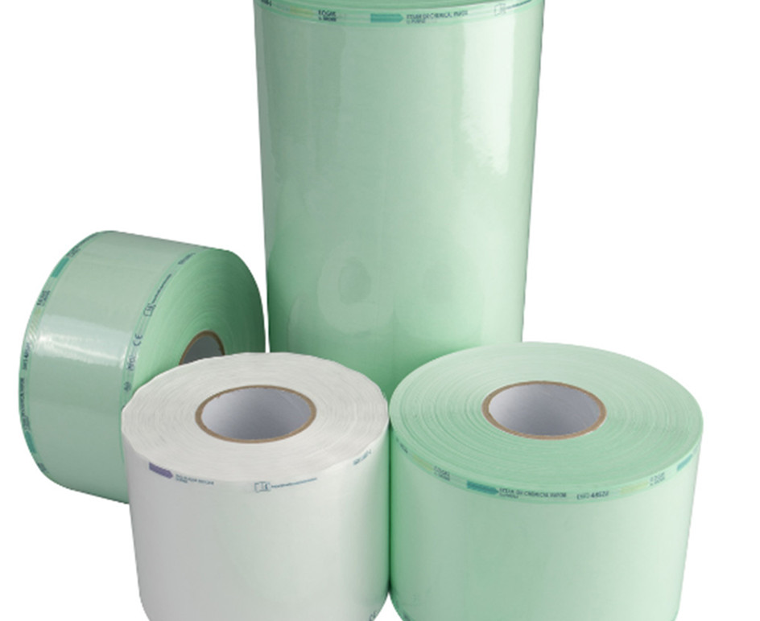
Specifications
Flat sealable POUCHES
Flat sealable REEL (customized lengths)
To enclose another medical device
Can be heat-sealed
Steam/chemical steam or ETO
Chemical process indicators
1,6 mil-thick film side
Quick and easy
Exist also in gusseted version in stead of flat

Slide 5
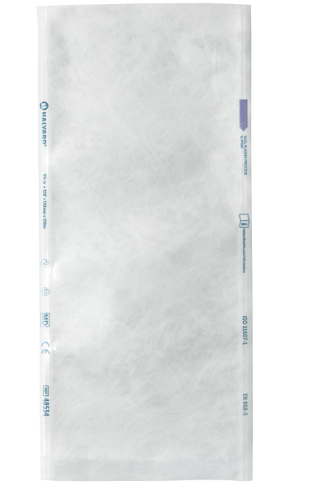
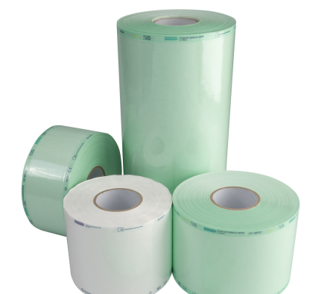
Specifications
Flat sealable POUCHES
Flat sealable REEL (customized lengths)
12 different widths and lenghts in stock
5 different widths on 200m rolls in stock
HALYARD* Material
Premium Medical Grade paper 68 gr/m2 + Green shined Polyester/Polypropylene Film: PET 12 microns/PE 40 microns
Printed chemical indicators
Steam = green to purple
ETO = yellow to brown

Slide 6
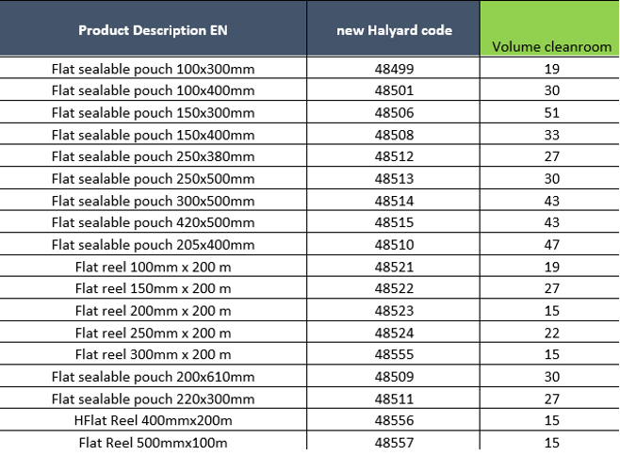
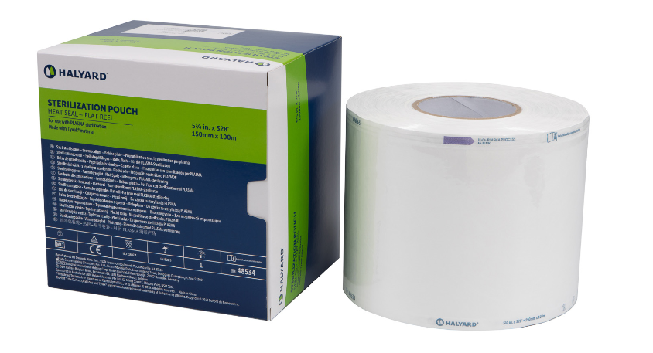
Cleanroom range Pouches and Reels

Slide 7
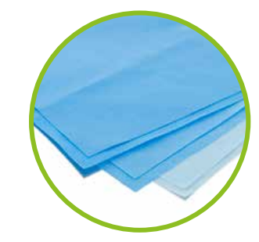
Product Positioning Wrapping Sheets
Who uses wraps?
Pharmaceutical Sterile Production: ISO 4/5 or Grade A/B aseptic
For what do controlled environments use them?
Inhouse packing + inhouse sterilization of their troleys, machinery parts, equipments, bottles, trays with tools...
Sterilisation methods: Autoclave(steam sterilisation) or chemical vapor (plasma) or inhouse ETO.
Inhouse packing + Outhouse sterilization of their troleys, transportcontainers.
Sterilisation methods: ETO and gamma / beta radiation

Slide 8
Sterilisations
Non-sterile delivered
Pre-vacuum steam sterilisation (4 min – 132C°; 30min – 135°C
Gravity steam sterilisation 30 min - 121°C
Gas plasma sterilisation including:
3 Main features
CE certifcated
Wrapping material
Per 93/42/EEC Directive on Medical Devices. Class of the device: barrier system in accordance to ISO 11607 Compatible with EN 868-2.
Specially designed
High Strength
Low-linting
Effective barrier : BFE>99%
Easy aseptic presentation
Available in multiple strengths from H100 to H500
Flame Retardant
Antistatic

Slide 9
Specifications
Features 2 layers of wrap, in 2 colours: blue and white, thermally bonded along the edges for a single-step wrapping resulting in 49% time saving and faster breach detection
Provides an excellent bacterial barrier adapted to the sequential wrapping techniques and assures and aseptic presentation

Slide 10
Specifications
Dimensions
Sequential wrap: 12 dimensions in 5 different strengths
Quick Check wrap: 8 dimensions in 5 different strengths
Material
SMS non-woven (polypropyleen)
2 sheets of 35.6g/m² (total 71.2g/m²). ONE-STEP* and QUICK CHECK* is thermally sealed on the edges
Indication
HALYARD* sterilization wrap is a disposable packaging material intended for use in the sterilization of medical products and for the maintenance of their sterility until use of the products

Slide 11
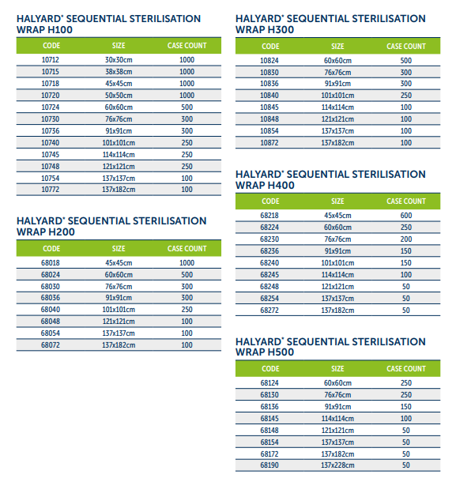
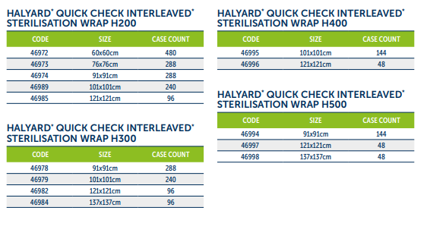
Range Wrapping Material

